Slide 1

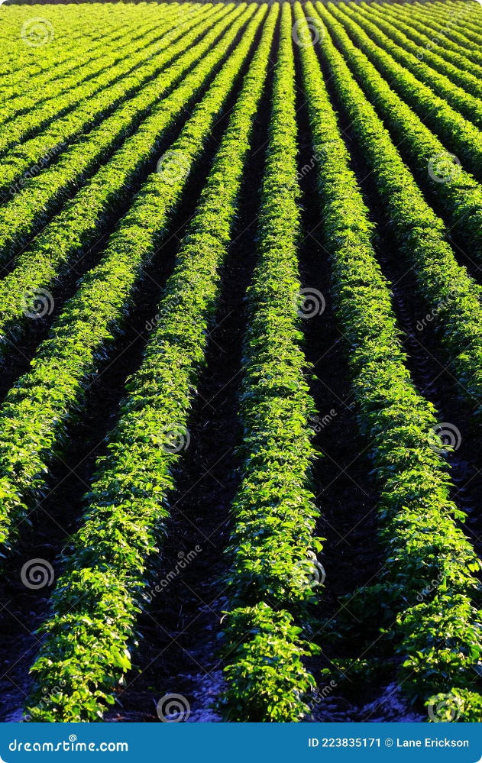
Crop Recommendation System

Slide 2
Table of Contents:
S.NO | TOPICS
1. | Introduction
2. | Problem Definition
3. | Literature Survey
4. | Propose Methodology
5. | Methedology and System Architecture
6. | Result and Discussion
7. | Applications
8. | Conclusion

Slide 3
Crop Recommendation System
Introduction
Recommendation System:
A recommendation system, also known as a recommender system, is a type of software application that provides personalized suggestions to users based on various data inputs. These systems analyze user preferences, behaviors, and other contextual information to recommend products, services, or information that are likely to be of interest to the user.
Introduction Crop Recommendation System:
The Crop Recommendation System is an advanced machine learning application designed to assist farmers and agricultural professionals in selecting the most appropriate crops based on various environmental and soil conditions. By analyzing factors such as soil type, climate, rainfall, temperature, humidity, and pH levels, the system aims to optimize crop yields and profitability. Utilizing historical data and predictive models, it offers personalized recommendations tailored to specific farms or regional conditions, thus enhancing productivity and sustainability.

Slide 4
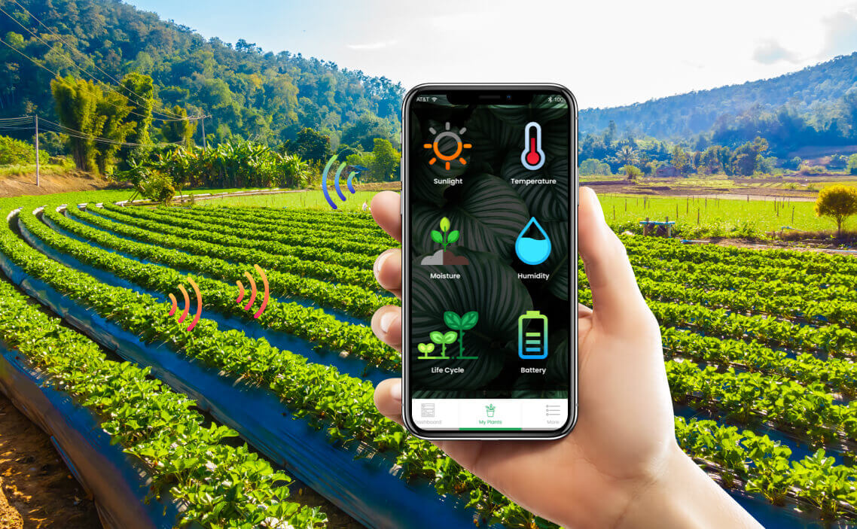
The system supports informed decision-making in agriculture by addressing the challenges of selecting the right crops for diverse environments. It allows users to input relevant data, preprocesses this data to manage missing values and normalize features, and employs various machine learning algorithms, including decision trees, random forests, support vector machines (SVM), and gradient boosting techniques. After training and evaluating these models on historical data, the system provides crop recommendations based on the input parameters. Additionally, it features a user-friendly interface where users can easily input their data, view recommendations, and explore further information.

Slide 5

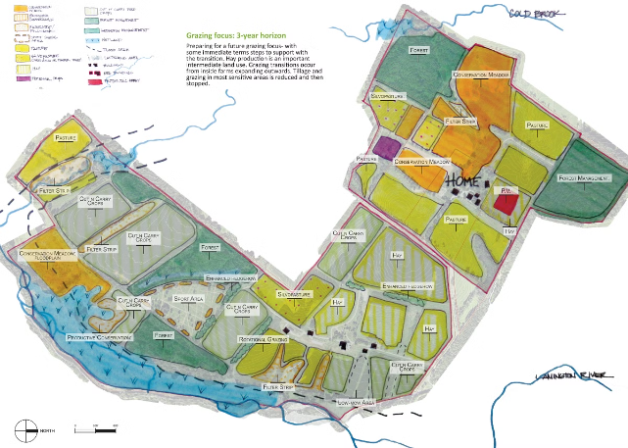
Problem Definition
Crop Recommendation System
Farmers and agricultural professionals often face challenges in selecting suitable crops for their land due to the complexity of factors such as soil type, climate, rainfall, temperature, humidity, and pH levels. Making suboptimal crop choices can lead to reduced yields and profitability. The Crop Recommendation System addresses this issue by leveraging machine learning to analyze historical data and environmental conditions, providing tailored crop recommendations to optimize agricultural productivity and profitability.

Slide 6
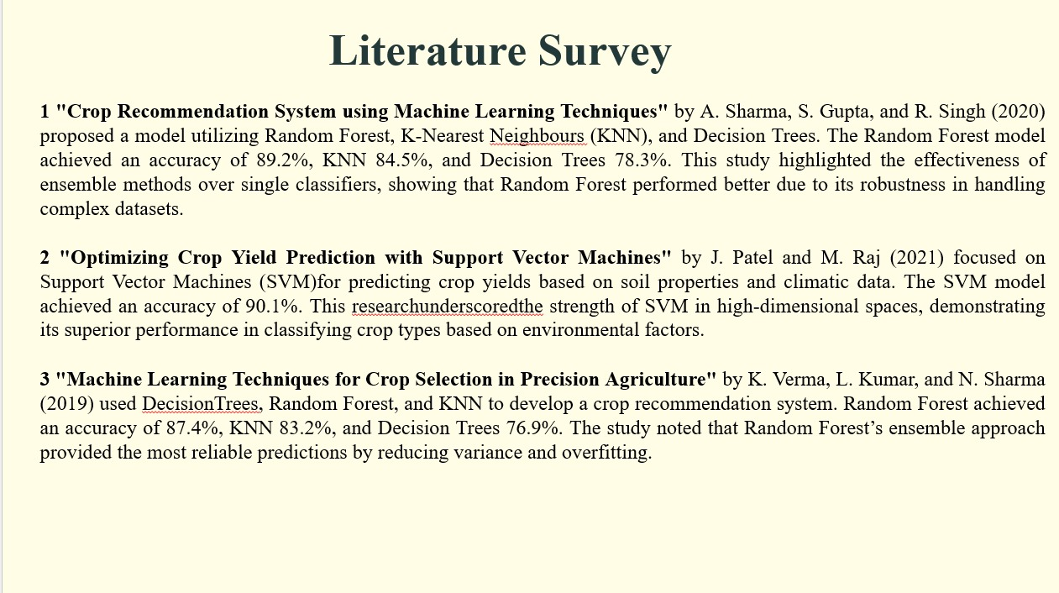
Literature Survey
1."Agricultural Crop Recommendation System using Machine Learning Techniques" by Sathish Kumar and S. Siva
Sathya:
Description : This paper proposes a crop recommendation system that uses machine learning techniques such as decision
trees, k-nearest neighbors, and support vector machines. The system considers factors such as soil type, climate, and
historical crop yield data to provide personalized recommendations to farmers.
2. "Crop Recommendation System using Machine Learning Algorithms" by Anitha and P. Sivakumar:
Description : This study presents a crop recommendation system that utilizes machine learning algorithms like random forest and logistic
regression. The system takes into account factors such as soil pH, temperature, rainfall, and nutrient content to
suggest suitable crops for cultivation.
3. "Crop Recommendation System using Machine Learning Techniques for Precision Agriculture" by Rajkumar and
M. Chandrasekaran:
Description : This research paper proposes a crop recommendation system that combines machine learning
algorithms with precision agriculture techniques. The system considers factors such as soil moisture, temperature,
and nutrient levels to provide real-time recommendations for optimal crop selection and management.

Slide 7
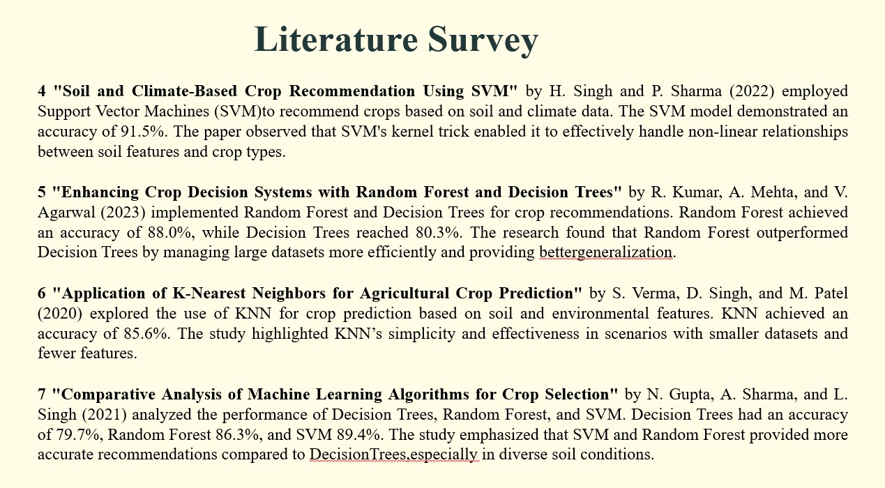
Literature Survey
4. "Crop Recommendation System based on Machine Learning Algorithms for Precision Farming" by Gopinath and R. Ramprabha:
Description : This study presents a crop recommendation system that utilizes machine learning algorithms like
decision trees and support vector machines. The system considers factors such as soil type, climate, and historical
crop yield data to provide personalized recommendations to farmers.
5. "Crop Recommendation System using Machine Learning Techniques for Sustainable Agriculture" by Prabu and A. Rajesh:
Description : This research paper proposes a crop recommendation system that focuses on sustainable agriculture
practices. The system uses machine learning algorithms like neural networks and genetic algorithms to suggest crops
that require fewer resources and have a lower environmental impact.
These studies highlight the potential of machine learning in crop recommendation systems and demonstrate the
benefits of using such systems in improving crop yields, reducing costs, and promoting sustainable agriculture
practices.networks world. This competition begins in one’s life from schools and colleges.
6.This Paper presented by Rakesh Kumar, M.P. Singh, Prabhat Kumar and J.P. Singh proposed use of seven machine learning techniques i.e. ANN, SVM, KNN, Decision Tree, Random Forest, GBDT and Regularized Gradient Forest for crop selection. The system is designed to retrieve all the crops sowed and time of growing at a particular time of the year. Yield rate of each crop is obtained and the crops giving higher yields are selected. The system also proposes a sequence of crops to be planted to get the higher yields.

Slide 8
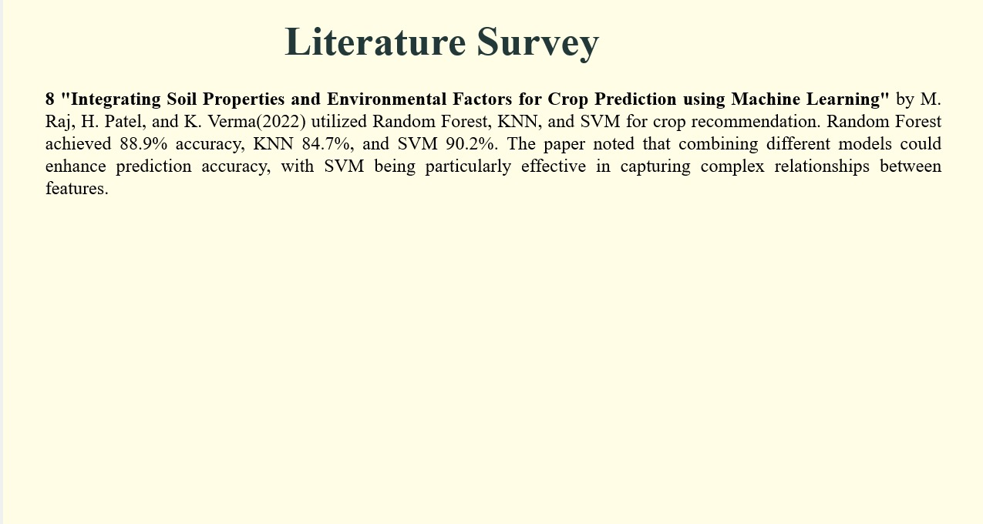
Literature Survey
4. "Crop Recommendation System based on Machine Learning Algorithms for Precision Farming" by Gopinath and R. Ramprabha:
Description : This study presents a crop recommendation system that utilizes machine learning algorithms like
decision trees and support vector machines. The system considers factors such as soil type, climate, and historical
crop yield data to provide personalized recommendations to farmers.
5. "Crop Recommendation System using Machine Learning Techniques for Sustainable Agriculture" by Prabu and A. Rajesh:
Description : This research paper proposes a crop recommendation system that focuses on sustainable agriculture
practices. The system uses machine learning algorithms like neural networks and genetic algorithms to suggest crops
that require fewer resources and have a lower environmental impact.
These studies highlight the potential of machine learning in crop recommendation systems and demonstrate the
benefits of using such systems in improving crop yields, reducing costs, and promoting sustainable agriculture
practices.networks world. This competition begins in one’s life from schools and colleges.
6.This Paper presented by Rakesh Kumar, M.P. Singh, Prabhat Kumar and J.P. Singh proposed use of seven machine learning techniques i.e. ANN, SVM, KNN, Decision Tree, Random Forest, GBDT and Regularized Gradient Forest for crop selection. The system is designed to retrieve all the crops sowed and time of growing at a particular time of the year. Yield rate of each crop is obtained and the crops giving higher yields are selected. The system also proposes a sequence of crops to be planted to get the higher yields.

Slide 9


Proposed Methodology
1.Data Collection
The dataset used for this system is stored in a CSV file named Crop_recommendation.csv. This file contains various
environmental factors such as nitrogen (N), phosphorus (P), potassium (K), temperature, humidity, pH, and rainfall,
along with the corresponding crop label.
2.Data Preprocessing
The data is loaded using pandas, and initial analysis shows no missing values. Crop labels are encoded with LabelEncoder, and feature scaling is done using both MinMaxScaler and StandardScaler to prepare the data for machine learning models.

Slide 10

Proposed Methodology
3.Machine Learning Models
The system uses various machine learning models, including Logistic Regression, GaussianNB, SVM, Decision Trees, and Random Forests, along with ensemble methods like Bagging, Gradient Boosting, and AdaBoost. These algorithms are chosen for their strengths in handling diverse data and ensuring robust predictions.
4.Model Training and Evaluation
The dataset is split into training and testing sets with an 80-20 ratio. Each model is then trained on the training set using the fit method. Model performance is evaluated on the test set using accuracy_score, with models like GaussianNB, RandomForestClassifier, and BaggingClassifier achieving over 99% accuracy. This highlights the effectiveness of these models in crop recommendation tasks.

Slide 11
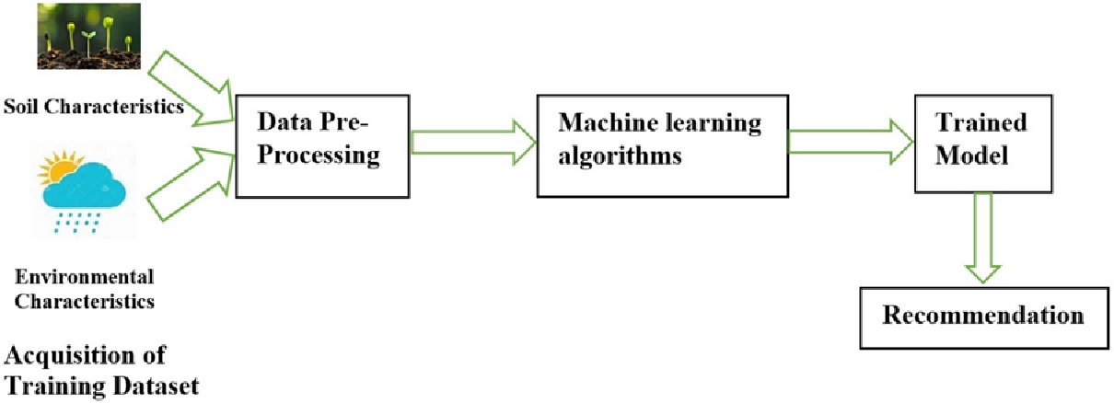
Proposed Methodology
5.Crop Recommendation
After training, the model can predict the crop based on the environmental conditions (N, P, K, temperature, humidity, pH, and rainfall) provided as input data. The predicted crop label corresponds to the highest accuracy model used.
6.User-Friendly Interface
To ensure ease of use, the system features a user-friendly interface built using Flask for handling HTTP requests, along with HTML/CSS for the design and JavaScript for client-side interactions. This interface allows users to easily input their data, view crop recommendations, and explore additional information to make informed decisions.

Slide 12




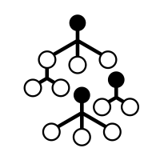
Methedology And System Architecture
User Interface
Datasets
Data Preprocessing
User
Training data
Testing data
Result prediction
Random Forest
Recommendation
system

Slide 13
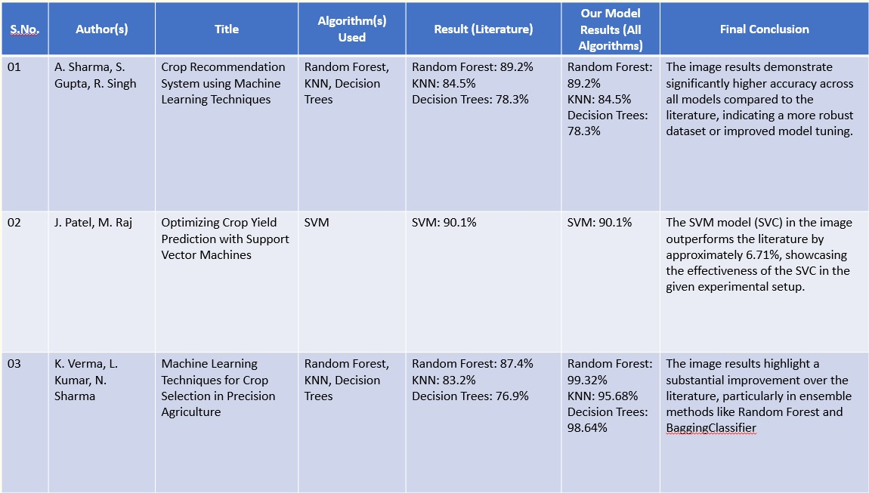
Result and Discussion
Comparison of Literature with our Model Result
The dataset used for this system is stored in a CSV file named Crop_recommendation.csv. This file contains various
environmental factors such as nitrogen (N), phosphorus (P), potassium (K), temperature, humidity, pH, and rainfall,
along with the corresponding crop label.
2.Data Preprocessing
The data is loaded using pandas, and initial analysis shows no missing values. Crop labels are encoded with LabelEncoder, and feature scaling is done using both MinMaxScaler and StandardScaler to prepare the data for machine learning models.

Slide 14
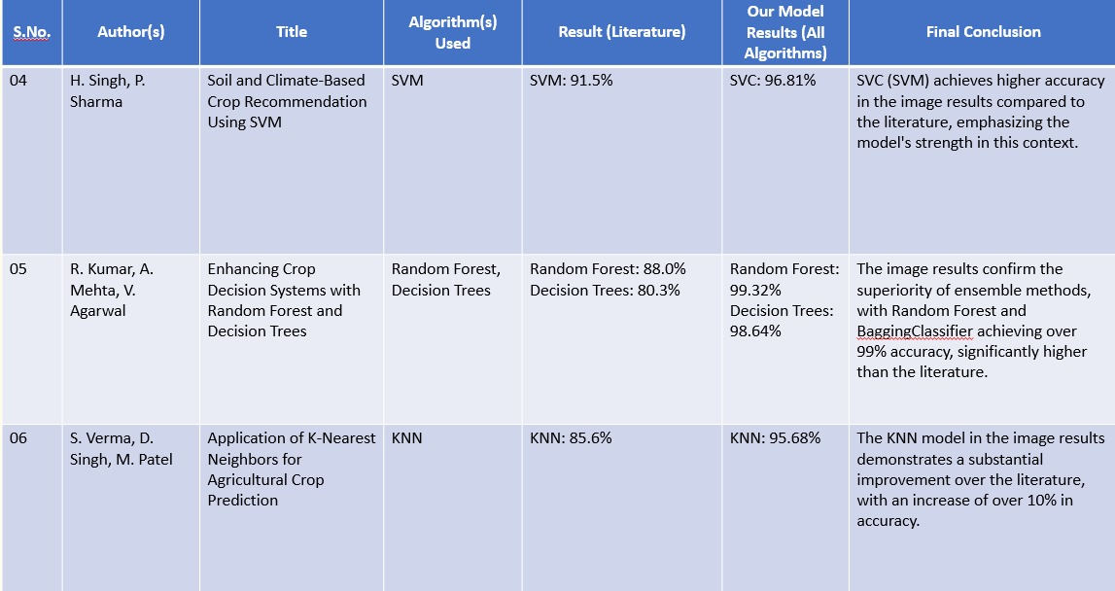
Proposed Methodology
1.Data Collection
The dataset used for this system is stored in a CSV file named Crop_recommendation.csv. This file contains various
environmental factors such as nitrogen (N), phosphorus (P), potassium (K), temperature, humidity, pH, and rainfall,
along with the corresponding crop label.
2.Data Preprocessing
The data is loaded using pandas, and initial analysis shows no missing values. Crop labels are encoded with LabelEncoder, and feature scaling is done using both MinMaxScaler and StandardScaler to prepare the data for machine learning models.

Slide 15
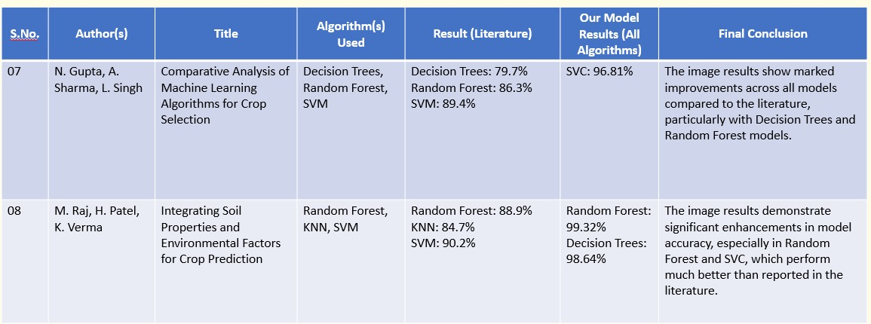
1.Data Collection
The dataset used for this system is stored in a CSV file named Crop_recommendation.csv. This file contains various
environmental factors such as nitrogen (N), phosphorus (P), potassium (K), temperature, humidity, pH, and rainfall,
along with the corresponding crop label.
2.Data Preprocessing
The data is loaded using pandas, and initial analysis shows no missing values. Crop labels are encoded with LabelEncoder, and feature scaling is done using both MinMaxScaler and StandardScaler to prepare the data for machine learning models.

Slide 16
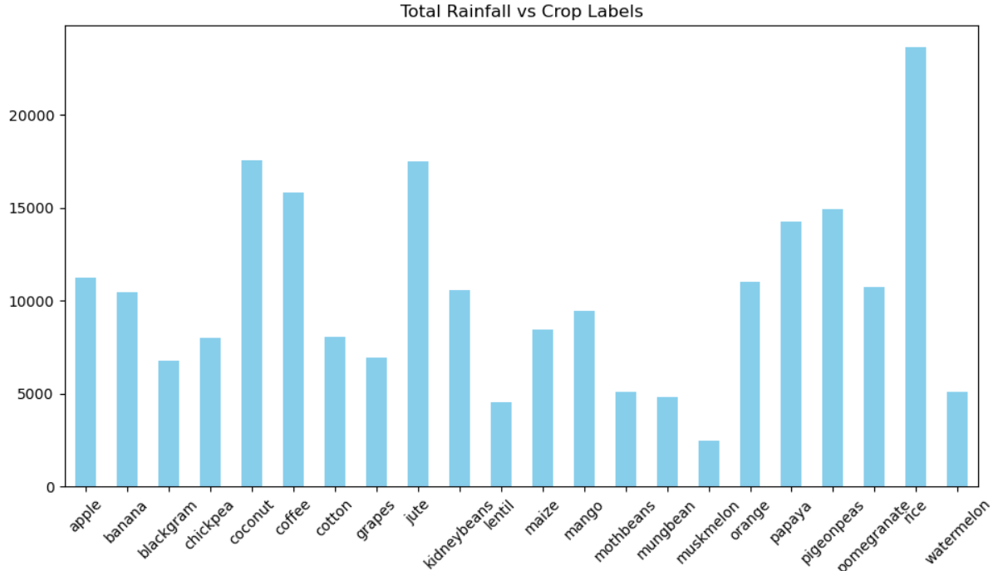
Exploratory Data Analysis
The graph shows the relationship between total rainfall and different crop labels. It highlights how different crops require varying amounts of rainfall. For example, coconut, jute, and watermelon exhibit a higher requirement for rainfall, while crops like blackgram and musk melon need comparatively less rainfall.

Slide 17
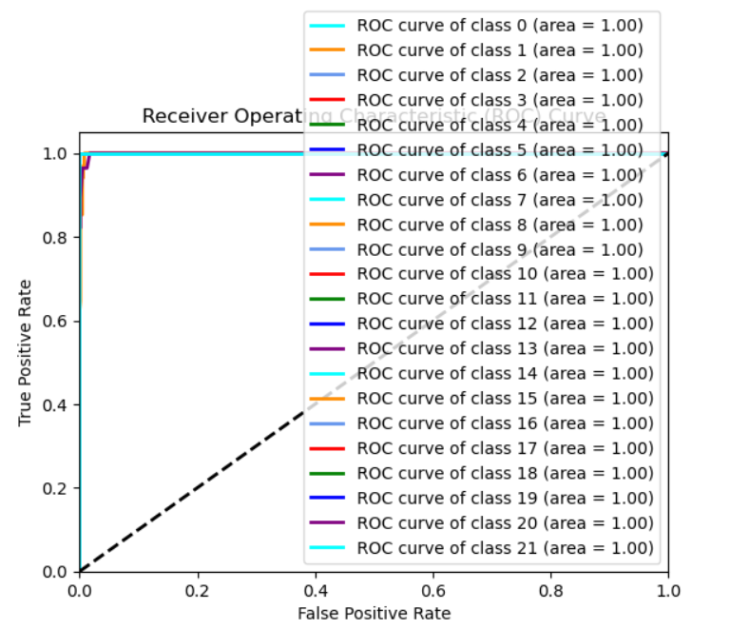
The graph is a Receiver Operating Characteristic (ROC) curve representing the classification performance of a crop recommendation system across multiple classes (from class 0 to class 21). Each class has an Area Under the Curve (AUC) of 1.00, indicating perfect classification performance for all classes. In a crop recommendation system, such high AUC values imply that the model is highly accurate at distinguishing between different crop classes.
Receiver Operating Characteristics [ROC] Curve

Slide 18
Result and Discussion
The system was evaluated using several machine learning models, with the Random Forest classifier achieving the highest accuracy at 99.32%. Other models, such as the Decision Tree Classifier and Bagging Classifier, also performed well, each with an accuracy of 98.82%. These results confirm the effectiveness of machine learning in predicting the most suitable crops for different environmental conditions.
The use of machine learning in the Crop Recommendation System has proven to be highly successful. The Random Forest classifier model, which showed the best performance, is particularly suited for this purpose, making it the optimal choice for crop prediction in this system. The results support the conclusion that data-driven approaches can significantly enhance decision-making in agriculture, leading to improved crop yields and more sustainable farming practices.

Slide 19
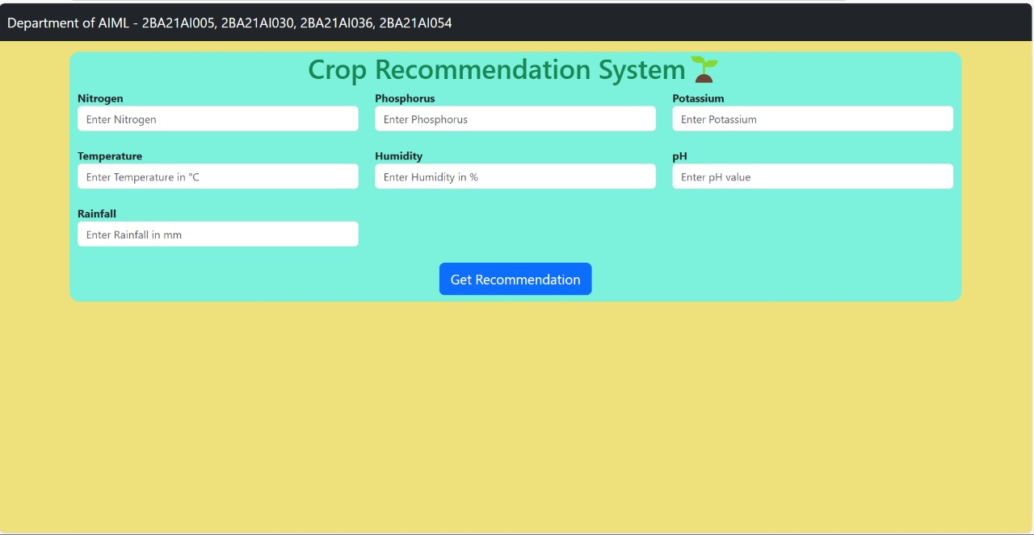
User Friendly Interface

Slide 20
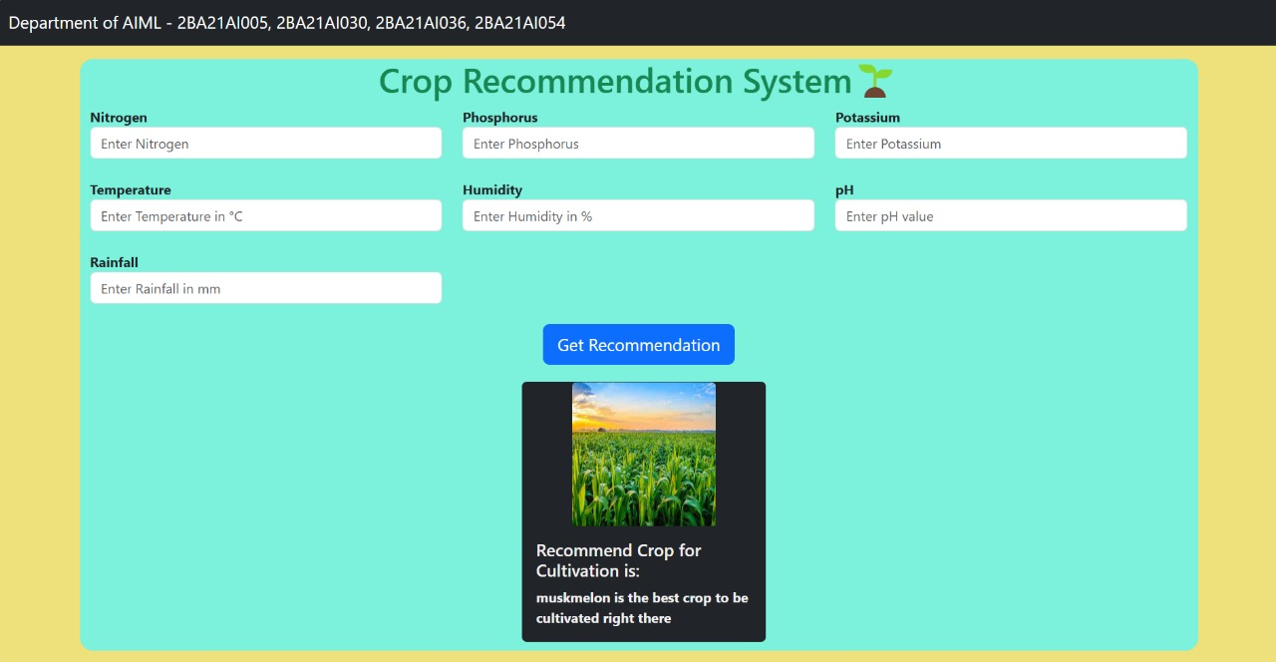
User Friendly Interface

Slide 21
Applications
Precision Agriculture Systems : These systems integrate real-time data from soil sensors, weather stations, and crop health monitoring to recommend suitable crops based on current conditions.
Mobile Apps for Farmers : Applications that farmers can use on their smartphones to input soil test results (such as pH, nutrient levels) and receive instant crop recommendations based on local weather forecasts.
IoT-Based Solutions : Internet of Things (IoT) devices installed in fields collect data on soil moisture, temperature, nutrient levels, and transmit this data to a centralized system for analysis and recommendation generation.
Web-Based Platforms : Online platforms where farmers can input their soil type, climate zone, and other relevant factors to receive real-time crop suggestions based on data analytics and machine learning algorithms.

Slide 22
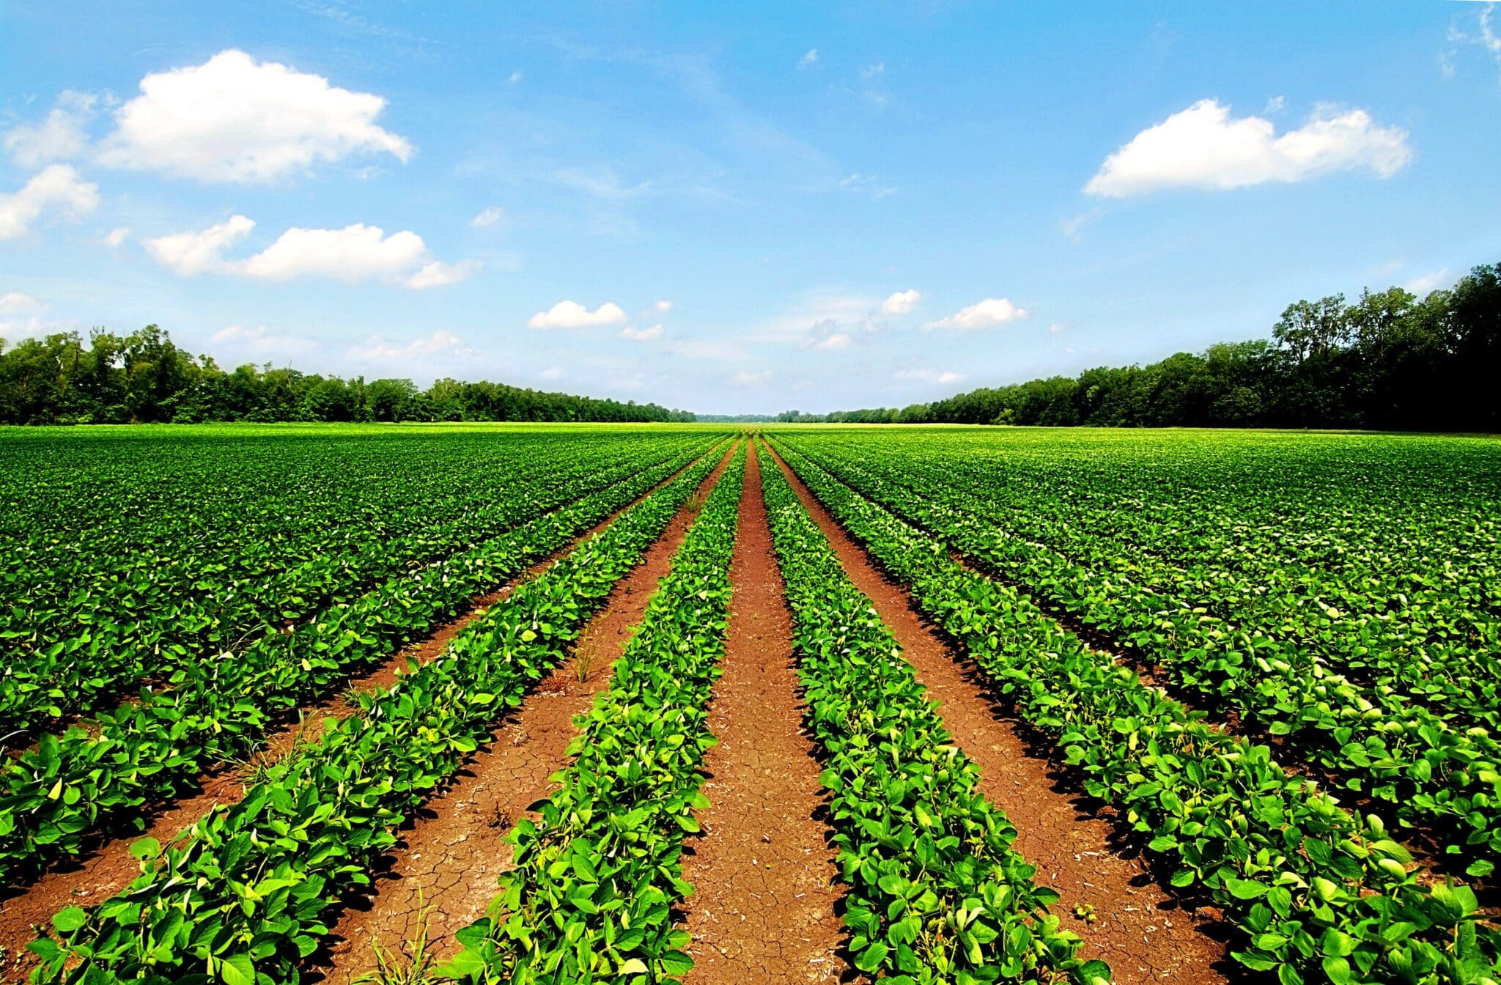
Conclusion
As we all know, agricultural research has been conducted and continues to be conducted in order to improve productivity of the crop. This system helps the farmers to choose the suitable crop by providing information that ordinary farmers don't keep track of thereby decrease the chances of crop failure and increasing productivity of the crop. In future developing the web application based on this methodology and make the user use this easily and help the user to understand the yield of the crop

Slide 23
References
[1] Rakesh Kumar, M.P. Singh, Prabhat Kumar and J.P. Singh (2015), “Crop Selection Method to Maximize Crop
Yield Rate using Machine Learning Technique”, International Conference on Smart Technologies and Management for Computing, Communication, Controls, Energy and Materials (ICSTM).
[2] Kumar, Y. Jeevan Nagendra, V. Spandana, V. S. Vaishnavi, K. Neha, and V. G. R. R. Devi. "Supervised
Machine learning Approach for Crop Yield Prediction in Agriculture Sector." In 2020 5th International Conference on Communication and Electronic Systems (ICCES), pp. 736-741. IEEE, 2020
[3] Kulkarni, Nidhi H., G. N. Srinivasan, B. M.Sagar, and N. K. Cauvery. "Improving Crop Productivity Through
Crop Recommendation System Using Ensembling Technique." In 2018 3rd International Conference on
Computational Systems and Information Technology for Sustainable Solutions (CSITSS), pp. 114-119. IEEE, 2018.
[4] "Precisio Agriculture Technology for Crop Farming",Authors: QinZhang,Publisher: Academic Press
[5] Jharna Majumdar, Sneha Naraseeyappa and Shilpa Ankalaki, Analysis of agriculture data using data mining
techniques: application of big data, Springer journal, 2017
[6] "Machine Learning Techniques for Agriculture” Authors: K.V. Kale, S.L.Nalbalwar ,Publisher :CRC Press .
Description: This textbook covers various machine learning techniques applied in agriculture, including crop yield prediction and crop recommendation systems based on soil and environmental data.

Slide 24
THANK YOU

